Slide 1
The Big Picture: Where are We Now?
The Five Classic Components of a Computer
Memory is usually implemented as:
Dynamic Random Access Memory (DRAM) - for main memory
Static Random Access Memory (SRAM) - for cache
Processor
Input
Control
Memory
Datapath
Output
Notes:
‹#›
So where are in in the overall scheme of things.
Well, we just finished designing the processor’s datapath.
Now I am going to show you how to design the control for the datapath.
+1 = 7 min. (X:47)

Slide 2
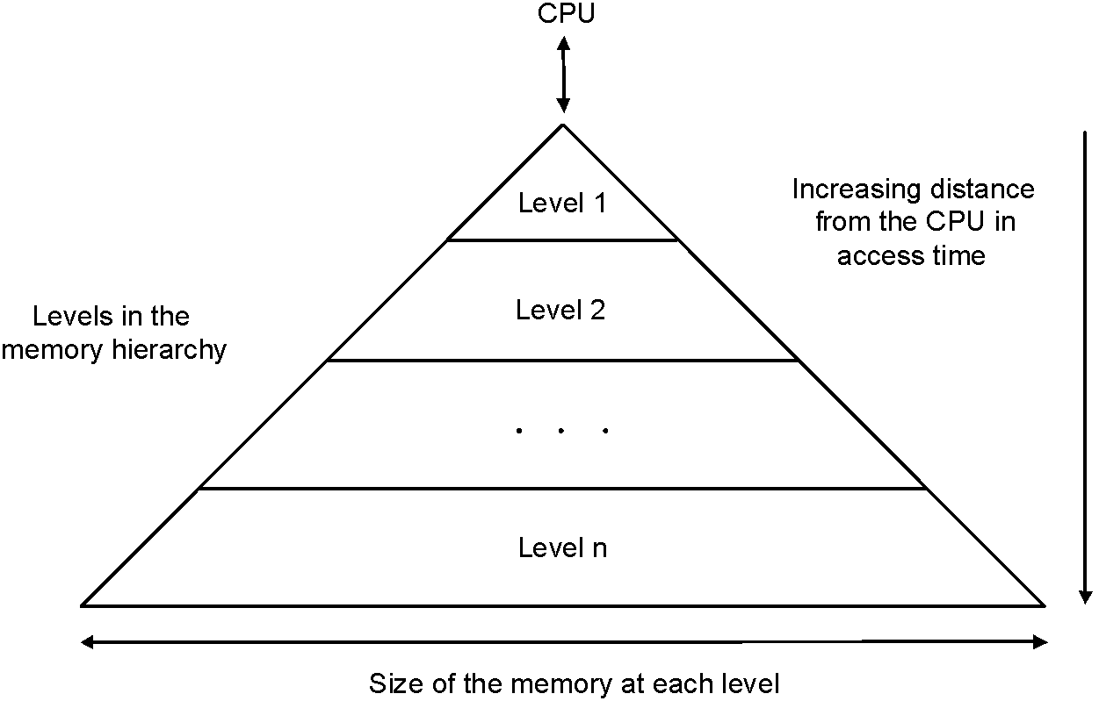
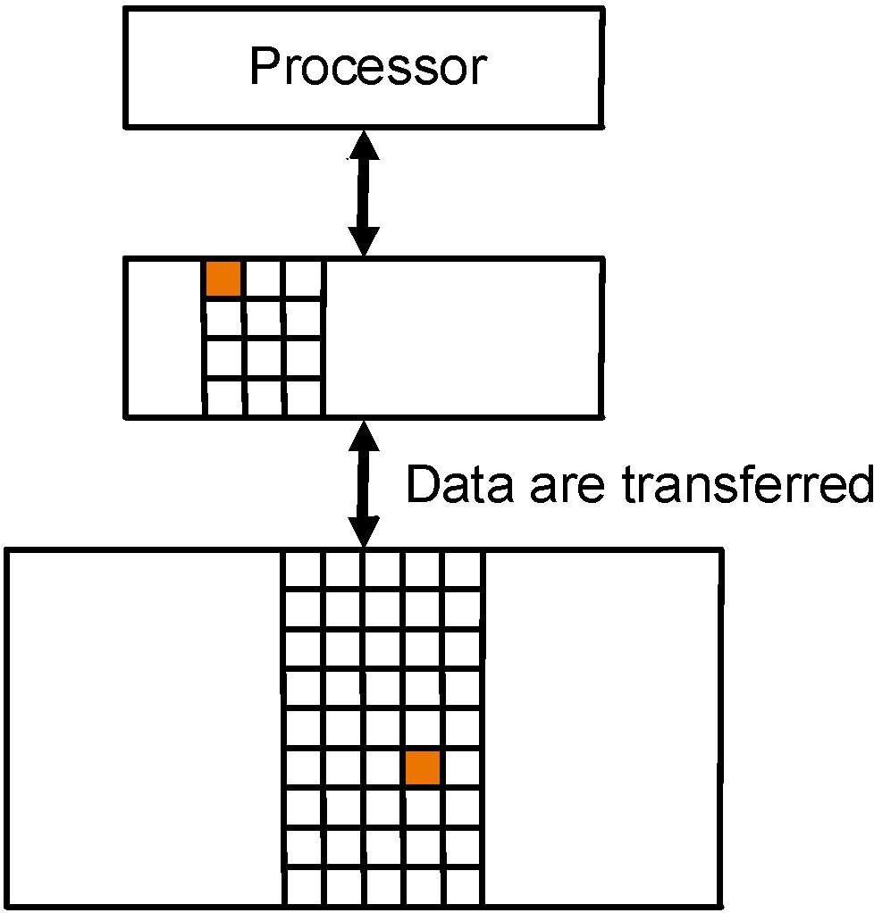
Memory Hierarchy
Memory technology | Typical access time | $ per GB in 2004
SRAM | 0.5–5 ns | $4000–$10,000
DRAM | 50–70 ns | $100–$200
Magnetic disk | 5,000,000–20,000,000 ns | $0.50–$2

Slide 3
Memory
SRAM:
Value is stored on a pair of inverting gates
Very fast but takes up more space than DRAM (4 to 6 transistors)
DRAM:
Value is stored as a charge on capacitor (must be refreshed)
Very small but slower than SRAM (factor of 5 to 10)
Notes:
‹#›

Slide 4
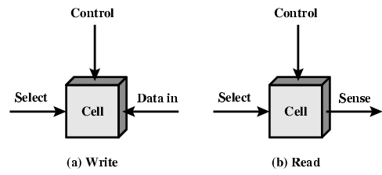
Memory Cell Operation

Slide 5
Dynamic RAM
Bits stored as charge in capacitors
Charges leak
Need refreshing even when powered
Simpler construction
Smaller per bit
Less expensive
Need refresh circuits
Slower
Main memory
Essentially analogue
Level of charge determines value
Notes:
‹#›

Slide 6
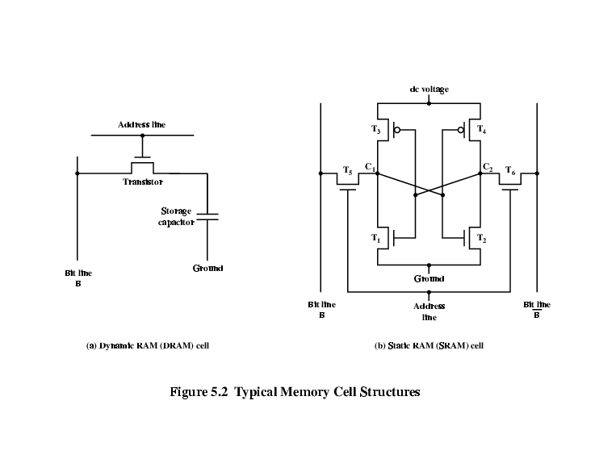
Dynamic RAM Structure

Slide 7
DRAM Operation
Address line active when bit read or written
Transistor switch closed (current flows)
Write
Voltage to bit line
High for 1 low for 0
Then signal address line
Transfers charge to capacitor
Read
Address line selected
transistor turns on
Charge from capacitor fed via bit line to sense amplifier
Compares with reference value to determine 0 or 1
Capacitor charge must be restored

Slide 8
Static RAM
Bits stored as on/off switches
No charges to leak
No refreshing needed when powered
More complex construction
Larger per bit
More expensive
Does not need refresh circuits
Faster
Cache
Digital
Uses flip-flops
Notes:
‹#›

Slide 9
Stating RAM Structure

Slide 10
Static RAM Operation
Transistor arrangement gives stable logic state
State 1
C₁ high, C₂ low
T₁ T₄ off, T₂ T₃ on
State 0
C₂ high, C₁ low
T₂ T₃ off, T₁ T₄ on
Address line transistors T₅ T₆ is switch
Write – apply value to B & compliment to B
Read – value is on line B

Slide 11
SRAM v DRAM
Both volatile
Power needed to preserve data
Dynamic cell
Simpler to build, smaller
More dense
Less expensive
Needs refresh
Larger memory units
Static
Faster
Cache

Slide 12
Organisation in detail
A 16Mbit chip can be organised as 1M of 16 bit words
A bit per chip system has 16 lots of 1Mbit chip with bit 1 of each word in chip 1 and so on
A 16Mbit chip can be organised as a 2048 x 2048 x 4bit array
Reduces number of address pins
Multiplex row address and column address
11 pins to address (2¹¹=2048)
Adding one more pin doubles range of values so x4 capacity
Notes:
‹#›

Slide 13
Refreshing
Refresh circuit included on chip
Disable chip
Count through rows
Read & Write back
Takes time
Slows down apparent performance
Notes:
‹#›

Slide 14
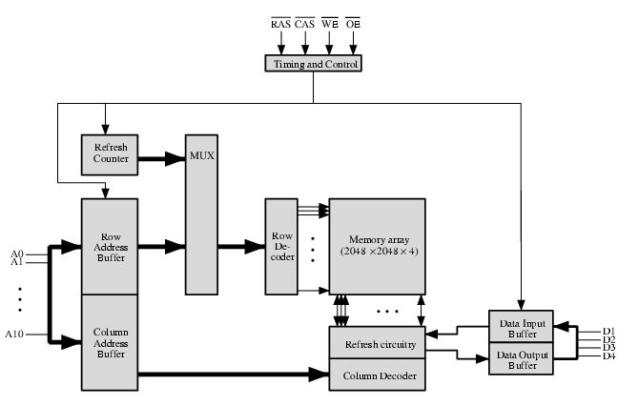
Typical 16 Mb DRAM (4M x 4)
Notes:
‹#›

Slide 15
Memory Hierarchy: How Does it Work?
Temporal Locality (Locality in Time):
=> Keep most recently accessed data items closer to the processor
Spatial Locality (Locality in Space):
=> Move blocks consists of contiguous words to the upper levels
Lower Level
Memory
To Processor
Upper Level
Memory
Blk X
From Processor
Blk Y
Notes:
‹#›
How does the memory hierarchy work? Well it is rather simple, at least in principle.
In order to take advantage of the temporal locality, that is the locality in time, the memory hierarchy will keep those more recently accessed data items closer to the processor because chances are (points to the principle), the processor will access them again soon.
In order to take advantage of the spatial locality, not ONLY do we move the item that has just been accessed to the upper level, but we ALSO move the data items that are adjacent to it.
+1 = 15 min. (X:55)

Slide 16
Memory Hierarchy: Terminology
Hit: data appears in some block in the upper level (example: Block X)
Hit Rate: the fraction of memory access found in the upper level
Hit Time: Time to access the upper level which consists of
RAM access time + Time to determine hit/miss
Miss: data needs to be retrieve from a block in the lower level (Block Y)
Miss Rate = 1 - (Hit Rate)
Miss Penalty: Time to replace a block in the upper level +
Time to deliver the block the processor
Hit Time << Miss Penalty
Lower Level
Memory
To Processor
Upper Level
Memory
Blk X
From Processor
Blk Y
Notes:
‹#›
A HIT is when the data the processor wants to access is found in the upper level (Blk X).
The fraction of the memory access that are HIT is defined as HIT rate.
HIT Time is the time to access the Upper Level where the data is found (X). It consists of:
(a) Time to access this level.
(b) AND the time to determine if this is a Hit or Miss.
If the data the processor wants cannot be found in the Upper level. Then we have a miss and we need to retrieve the data (Blk Y) from the lower level.
By definition (definition of Hit: Fraction), the miss rate is just 1 minus the hit rate.
This miss penalty also consists of two parts:
(a) The time it takes to replace a block (Blk Y to BlkX) in the upper level.
(b) And then the time it takes to deliver this new block to the processor.
It is very important that your Hit Time to be much much smaller than your miss penalty. Otherwise, there will be no reason to build a memory hierarchy.
+2 = 14 min. (X:54)

Slide 17
Memory Hierarchy of a Modern Computer System
By taking advantage of the principle of locality:
Present the user with as much memory as is available in the cheapest technology.
Provide access at the speed offered by the fastest technology.
Processor
Control
Tertiary
Storage
(Tape)
Secondary
Storage
(Disk)
Second
Level
Cache
(SRAM)
Main
Memory
(DRAM)
Datapath
On-Chip
Cache
Registers
Speed (ns):
1s
10s
100s
10,000,000s
(10s ms)
10,000,000,000s
(10s sec)
Size (bytes):
100s
Ks
Ms
Gs
Ts
Notes:
‹#›
The design goal is to present the user with as much memory as is available in the cheapest technology (points to the disk).
While by taking advantage of the principle of locality, we like to provide the user an average access speed that is very close to the speed that is offered by the fastest technology.
(We will go over this slide in details in the next lecture on caches).
+1 = 16 min. (X:56)

Slide 18
General Principles of Memory
Locality
Temporal Locality: referenced memory is likely to be referenced again soon (e.g. code within a loop)
Spatial Locality: memory close to referenced memory is likely to be referenced soon (e.g., data in a sequentially access array)
Definitions
Upper: memory closer to processor
Block: minimum unit that is present or not present
Block address: location of block in memory
Hit: Data is found in the desired location
Hit time: time to access upper level
Miss rate: percentage of time item not found in upper level
Locality + smaller HW is faster = memory hierarchy
Levels: each smaller, faster, more expensive/byte than level below
Inclusive: data found in upper level also found in the lower level
Notes:
‹#›

Slide 19
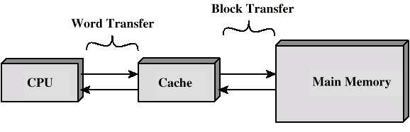
Cache
Small amount of fast memory
Sits between normal main memory and CPU
May be located on CPU chip or module
Notes:
‹#›

Slide 20
Cache operation - overview
CPU requests contents of memory location
Check cache for this data
If present, get from cache (fast)
If not present, read required block from main memory to cache
Then deliver from cache to CPU
Cache includes tags to identify which block of main memory is in each cache slot
Notes:
‹#›

Slide 21
Cache Design
Size
Mapping Function
Replacement Algorithm
Write Policy
Block Size
Number of Caches
Notes:
‹#›

Slide 22
Relationship of Caches and Pipeline
Memory
I-$
D-$
Next PC
Next SEQ PC
Adder
MUX
Adder
4
Zero?
Memory
RS1
RS2
Reg File
Address
EX/MEM
ID/EX
MEM/WB
IF/ID
ALU
Data
Memory
MUX
WB Data
MUX
Sign
Extend
Imm
RD
RD
RD
Notes:
‹#›

Slide 23
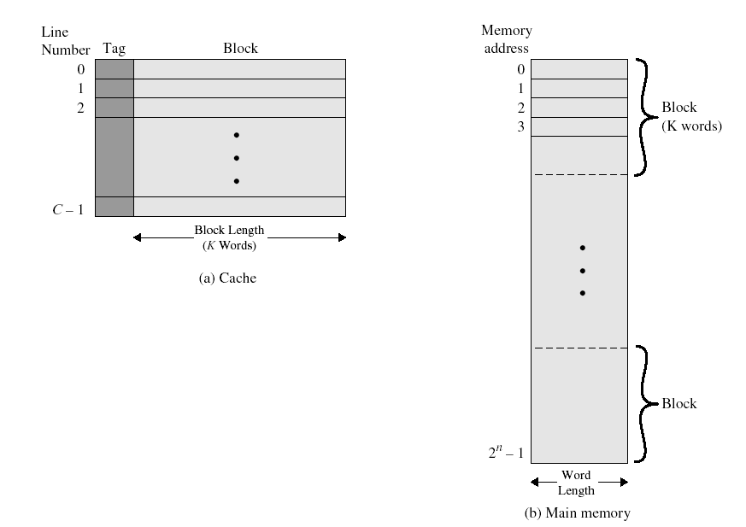
Cache/memory structure

Slide 24
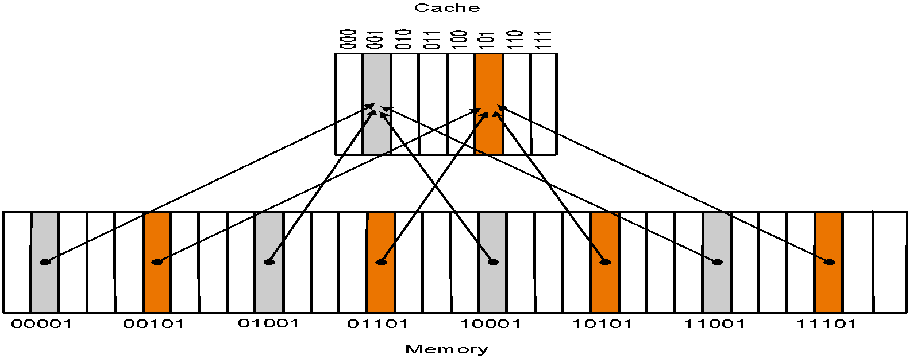
Direct Mapped Cache
Mapping: memory mapped to one location in cache: (Block address) mod (Number of blocks in cache)
Number of blocks is typically a power of two, i.e., cache location obtained from low-order bits of address.
Notes:
‹#›

Slide 25
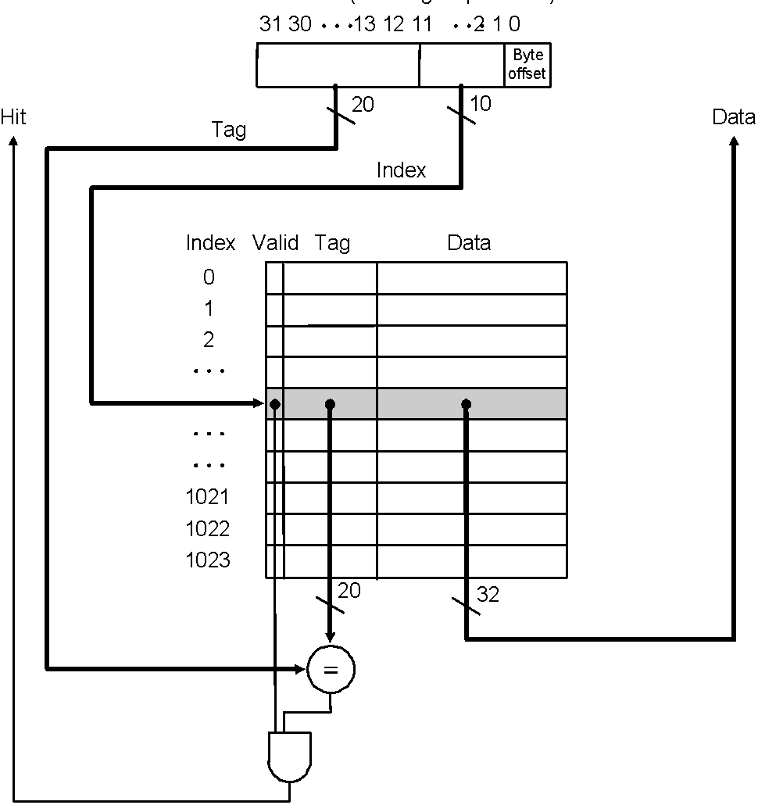
Locating data in the Cache
Index is 10 bits, while tag is 20 bits
We need to address 1024 (2¹⁰) words
We could have any of 2²⁰ words per cache location
Valid bit indicates whether an entry contains a valid address or not
Tag bits is usually indicated by address size – (log₂(memory size) + 2)
E.g. 32 – (10 + 2) = 20

Slide 26
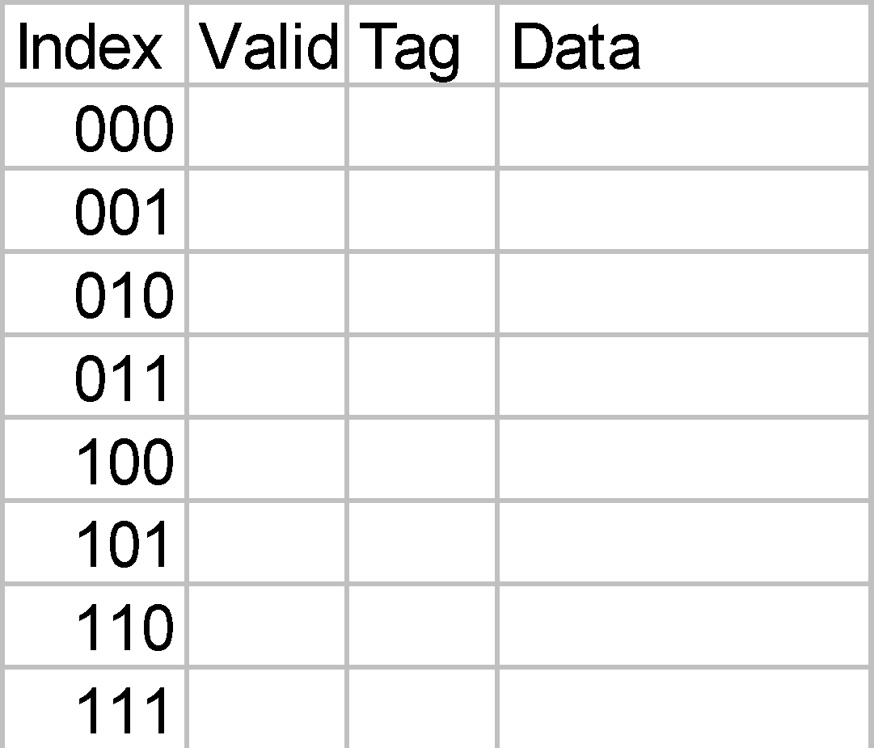
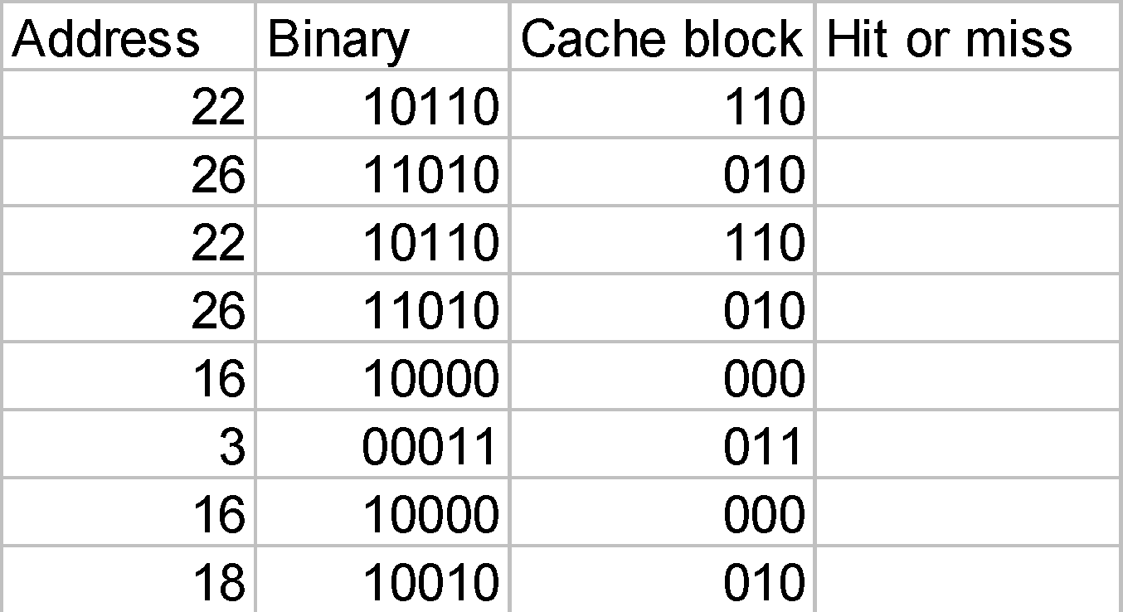
Example
32-word memory
8-word cache
(The addresses below are word addresses.)

Slide 27
Example-Bits in Cache
How many total bits are required for a direct-mapping cache with 16KB of data and 4-word blocks, assuming a 32-bit address.

Slide 28
Example – Mapping an Address to a Cache Block
Consider a cache with 64 blocks and a block size of 16 bytes. What block number does byte address 1200 (10010110000b) map to? What’s about 1204?

Slide 29
Cache Misses - Read
The control unit
must detect a miss
Stall the entire processor
fetch the requested data from memory
Steps taken by the control unit on an instruction cache miss
Send PC-4 to memory
Start reading the main memory
Transferring block to the cache
Restart the instruction to start fetching from the cache

Slide 30
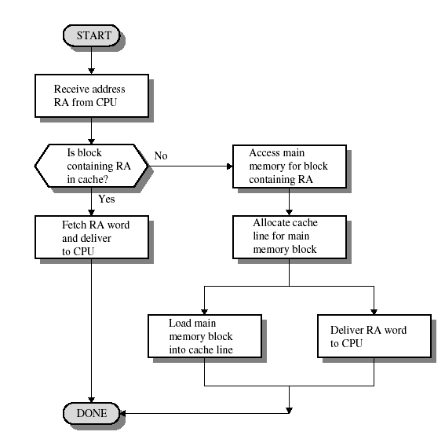
Cache Read Operations

Slide 31
Cache Misses - Writes
On an instruction cache miss, we
Index the cache using bits 15-2 of the address
Write the cache entry
Data from processor is placed in data portion
Bits 31-16 of address written into tag field
Turn valid bit on
Write the word to main memory using the entire address
How do we keep main memory up to date ?
Write-through means writing to both cache and main memory when a miss occurs (to avoid inconsistent or untrue memories)
Write buffer uses a fast and small memory to store the cache writes while it is waiting to be written out to memory (in MIPS, it is 4 words)
Write-back means writing out to main memory only when the block is swapped out

Slide 32
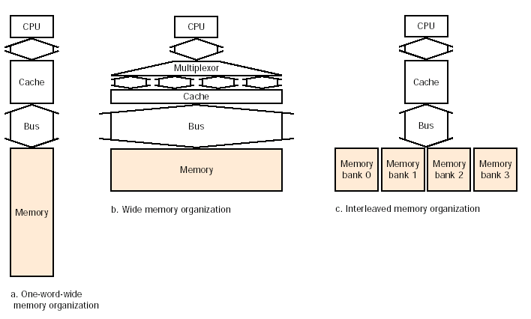
Memory Organizations (1)
In part a, all components are one word wide
In part b, a wider memory, bus and cache are utilized
In part c, interleaved memory banks with a narrow bus and cache are utilized

Slide 33
Memory Organizations (2)
Assume that it takes
1 clock cycle to send the referenced address
15 clock cycles for each DRAM access initiated
1 clock cycle to send a word of data
In part a, we have a 1 + (4 x 15) + (4 x 1) = 65 clock cycle miss penalty, and a (4x4)/65 = 0.25 bytes per clock cycle
In part b, we have a 1 + (2 x 15) + (2 x 1) = 33 clock cycle miss penalty, and a (4x4)/33 = 0.48 bytes per clock cycle (assuming memory width of two words)
Wider bus and higher cache access time
In part c, we have a 1 + (1x15) + (4 x 1) = 20 clock cycle miss penalty, and a (4x4)/20 = 0.80 bytes per clock cycle (assuming 4 interleaving banks)

Slide 34
Four Questions for Memory Hierarchy Designers
Q1: Where can a block be placed in the upper level? (Block placement)
Q2: How is a block found if it is in the upper level? (Block identification)
Q3: Which block should be replaced on a miss? (Block replacement)
Q4: What happens on a write? (Write strategy)
Notes:
‹#›

Slide 35
Q1: Where can a block be placed?
Direct Mapped: Each block has only one place that it can appear in the cache.
Fully associative: Each block can be placed anywhere in the cache.
Set associative: Each block can be placed in a restricted set of places in the cache.
If there are n blocks in a set, the cache placement is called n-way set associative
What is the associativity of a direct mapped cache?

Slide 36
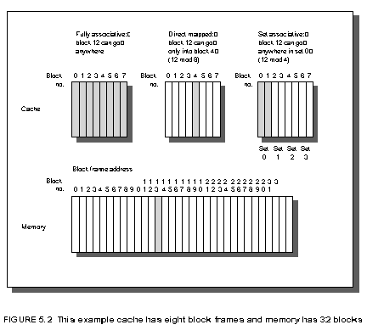
Associativity Examples
Cache size is 8 blocks
Where does word 12 from memory go?
Fully associative:
Block 12 can go anywhere
Direct mapped:
Block no. = (Block address) mod
(No. of blocks in cache)
Block 12 can go only into block 4
(12 mod 8 = 4)
=> Access block using lower 3 bits
2-way set associative:
Set no. = (Block address) mod
(No. of sets in cache)
Block 12 can go anywhere in set 0
(12 mod 4 = 0)
=> Access set using lower 2 bits

Slide 37
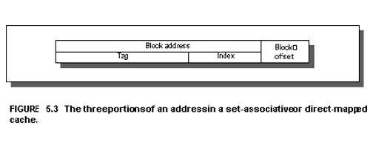
Q2: How Is a Block Found?
The address can be divided into two main parts
Block offset: selects the data from the block
offset size = log2(block size)
Block address: tag + index
index: selects set in cache
index size = log2(#blocks/associativity)
tag: compared to tag in cache to determine hit
tag size = addreess size - index size - offset size
Each block has a valid bit that tells if the block is valid - the block is in the cache if the tags match and the valid bit is set.
Tag
Index
Notes:
‹#›

Slide 38
Q3: Which Block Should be Replaced on a Miss?
Easy for Direct Mapped - only on choice
Set Associative or Fully Associative:
Random - easier to implement
Least Recently used - harder to implement
Miss rates for caches with different size, associativity and replacemnt algorithm.
Associativity: 2-way 4-way 8-way
Size LRU Random LRU Random LRU Random
16 KB 5.18% 5.69% 4.67% 5.29% 4.39% 4.96%
64 KB 1.88% 2.01% 1.54% 1.66% 1.39% 1.53%
256 KB 1.15% 1.17% 1.13% 1.13% 1.12% 1.12%
For caches with low miss rates, random is almost as good as LRU.
Notes:
‹#›

Slide 39
Q4: What Happens on a Write?
Write through: The information is written to both the block in the cache and to the block in the lower-level memory.
Write back: The information is written only to the block in the cache. The modified cache block is written to main memory only when it is replaced.
is block clean or dirty? (add a dirty bit to each block)
Pros and Cons of each:
Write through
Read misses cannot result in writes to memory,
Easier to implement
Always combine with write buffers to avoid memory latency
Write back
Less memory traffic
Perform writes at the speed of the cache
Notes:
‹#›

Slide 40
Q4: What Happens on a Write?
Since data does not have to be brought into the cache on a write miss, there are two options:
Write allocate
The block is brought into the cache on a write miss
Used with write-back caches
Hope subsequent writes to the block hit in cache
No-write allocate
The block is modified in memory, but not brought into the cach
Used with write-through caches
Writes have to go to memory anyway, so why bring the block into the cache

Slide 41
Measuring Cache Performance
CPU time = (CPU execution clock cycles +
Memory stall clock cycles) × Clock-cycle time
Memory stall clock cycles =
Read-stall cycles + Write-stall cycles
Read-stall cycles = Reads/program × Read miss rate ×
Read miss penalty
Write-stall cycles = (Writes/program × Write miss rate ×
Write miss penalty) + Write buffer stalls
(assumes write-through cache)
Write buffer stalls should be negligible and write and read miss penalties equal (cost to fetch block from memory)
Memory stall clock cycles = Mem access/program × miss rate × miss penalty

Slide 42
Example I
Assume I-miss rate of 2% and D-miss rate of 4% (gcc)
Assume CPI = 2 (without stalls) and miss penalty of 40 cycles
Assume 36% loads/stores
What is the CPI with memory stalls?
How much faster would a machine with perfect cache run?
What happens if the processor is made faster, but the memory system stays the same (e.g. reduce CPI to 1)?
How does Amdahls’s law come into play?

Slide 43
Calculation I
Instruction miss cycles = I x 100% x 2% x 40 = .80 x I
Data miss cycles = I x 36% x 4% x 40 = .58 x I
Total miss cycles = .80 x I + .58 x I = 1.38 x I
CPI = 2 + 1.38 = 3.38
Perf_{Perf} / Perf_{Stall} = 3.38/2 = 1.69
For a processor with base CPI = 1:
CPI = 1 + 1.38 = 2.38 🡺 Perf_{Perf} / Perf_{Stall} = 2.38
Time spent on stalls for slower processor 1.38/3.38 = 41%
Time spent on stalls for faster processor 1.38/2.38 = 58%

Slide 44
Example II
Suppose the performance of the machine in the previous example is improved by doubling the clock speed (main memory speed remains the same). Hint: since the clock rate is doubled and the memory speed remains the same, the miss penalty becomes twice as much (80 cycles).
How much faster will the machine be assuming the same miss rate as the previous example?

Slide 45
Calculation II
If clock speed is doubled but memory speed remains same:
Instruction miss cycles = I x 100% x 2% x 80 = 1.60 x I
Data miss cycles = I x 36% x 4% x 80 = 1.16 x I
Total miss cycles = 1.60 x I + 1.16 x I = 2.76 x I
CPI = 2 + 2.76 = 4.76
Perf_{Fast} / Perf_{Slow} = ( I x 3.38 x L ) / ( I x 4.76 x L/2 ) = 1.41
Conclusion: Relative cache penalties increase as the machine becomes faster.

Slide 46
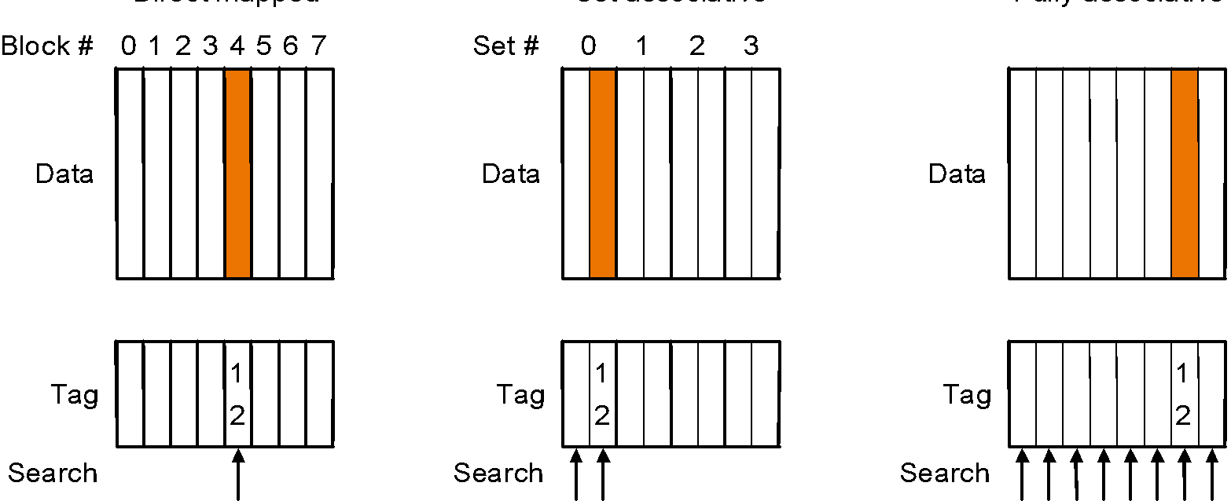
Reducing Cache Misses with a more Flexible Replacement Strategy
In a direct mapped cache a block can go in exactly one place in cache
In a fully associative cache a block can go anywhere in cache
A compromise is to use a set associative cache where a block can go into a fixed number of locations in cache, determined by:
(Block number) mod (Number of sets in cache)

Slide 47
Example
Three small 4 word caches:
Direct mapped, two-way set associative, fully associative
How many misses in the sequence of block addresses: 0, 8, 0, 6, 8?
How does this change with 8 words, 16 words?

Slide 48
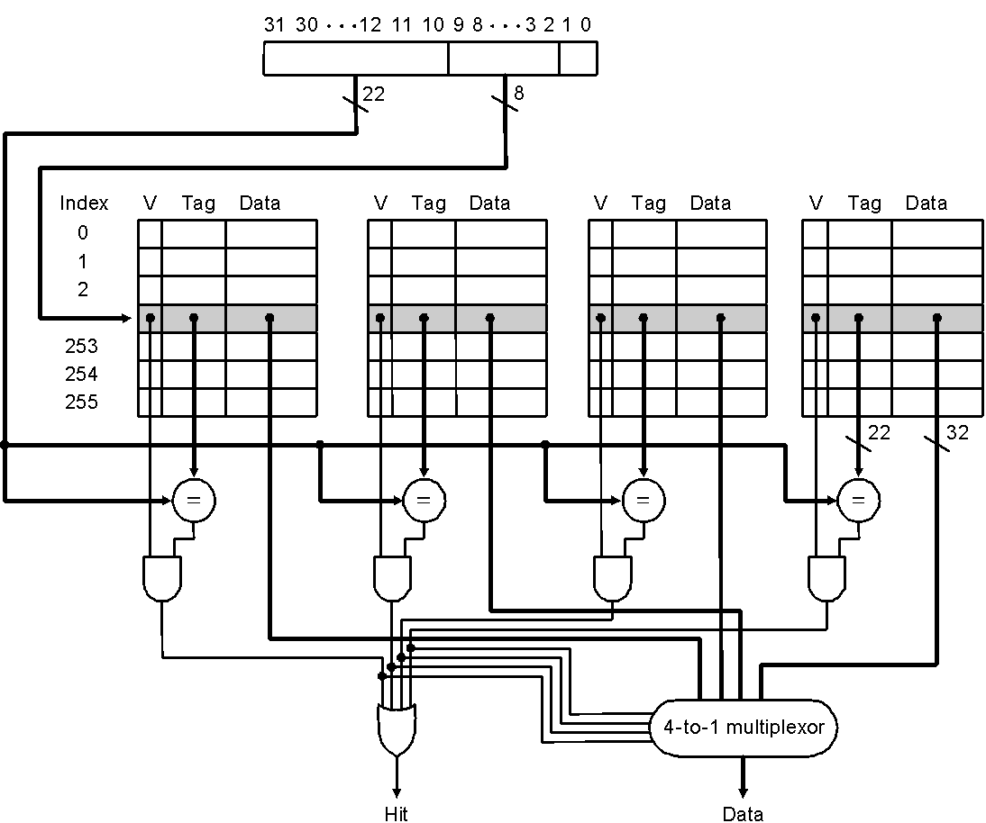
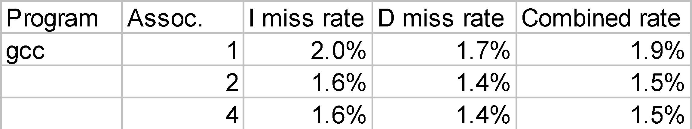
Locating a Block in Cache
Check the tag of every cache block in the appropriate set
Address consists of 3 parts
Replacement strategy:
E.G. Least Recently Used (LRU)

Slide 49
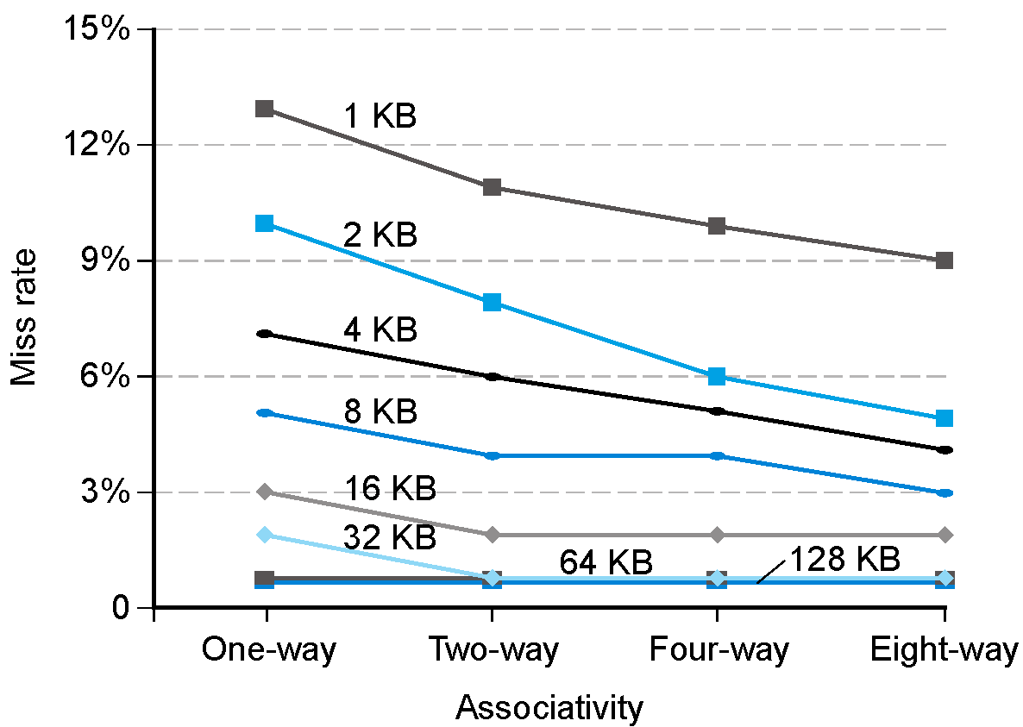
Effect of associativity on performance
Notes:
‹#›

Slide 50
Size of Tags vs. Associativity
Increasing associativity requires more comparators, as well as more tag bits per cache block.
Assume a cache with 4K 4-word blocks and 32 bit addresses
Find the total number of sets and the total number of tag bits for a
direct mapped cache
two-way set associative cache
four-way set associative cache
fully associative cache

Slide 51
Size of Tags vs. Associativity
Total cache size 4K x 4 words/block x 4 bytes/word = 64Kb
Direct mapped cache:
16 bytes/block 🡺 28 bits for tag and index
# sets = # blocks
Log(4K) = 12 bits for index 🡺 16 bits for tag
Total # of tag bits = 16 bits x 4K locations = 64 Kbits
Two-way set-associative cache:
32 bytes / set
16 bytes/block 🡺 28 bits for tag and index
# sets = # blocks / 2 🡺 2K sets
Log(2K) = 11 bits for index 🡺 17 bits for tag
Total # of tag bits = 17 bits x 2 location / set x 2K sets = 68 Kbits

Slide 52
Size of Tags vs. Associativity
Four-way set-associative cache:
64 bytes / set
16 bytes/block 🡺 28 bits for tag and index
# sets = # blocks / 4 🡺 1K sets
Log(1K) = 10 bits for index 🡺 18 bits for tag
Total # of tag bits = 18 bits x 4 location / set x 1K sets = 72 Kbits
Fully associative cache:
1 set of 4 K blocks 🡺 28 bits for tag and index
Index = 0 bits 🡺 tag will have 28 bits
Total # of tag bits = 28 bits x 4K location / set x 1 set = 112 Kbits

Slide 53
Reducing the Miss Penalty using Multilevel Caches
To further reduce the gap between fast clock rates of CPUs and the relatively long time to access memory additional levels of cache are used (level two and level three caches).
The primary cache is optimized for a fast hit rate, which implies a relatively small size
A secondary cache is optimized to reduce the miss rate and penalty needed to go to memory.
Example:
Assume CPI = 1 (with all hits) and 5 GHz clock
100 ns main memory access time
2% miss rate for primary cache
Secondary cache with 5 ns access time and miss rate of .5%
What is the total CPI with and without secondary cache?
How much of an improvement does secondary cache provide?

Slide 54
Reducing the Miss Penalty using Multilevel Caches
The miss penalty to main memory: 100 ns / .2 ns per cycle = 500 cycles
For the processor with only L1 cache: Total CPI = 1 + 2% x 500 = 11
The miss penalty to access L2 cache: 5 ns / .2 ns per cycle = 25 cycles
If the miss is satisfied by L2 cache, then this is the only miss penalty.
If the miss has to be resolved by the main memory, then the total miss penalty is the sum of both
For the processor with both L1 and L2 caches: Total CPI = 1 + 2% x 25 + 0.5% x 500 = 4
The performance ratio: 11 / 4 = 2.8!

Slide 55
Memory Hierarchy Framework
Three Cs used to model our memory hierarchy
Compulsory misses
Cold-start misses caused by the first access to a block
Solution is to increase the block size
Capacity misses
Caused when the cache is full and block needs to be replaced
Solution is to enlarge the cache
Conflict misses
Collision misses caused when multiple blocks compete for the same set, in the case of set-associative and fully-associative mappings
Solution is to increase associativity

Slide 56
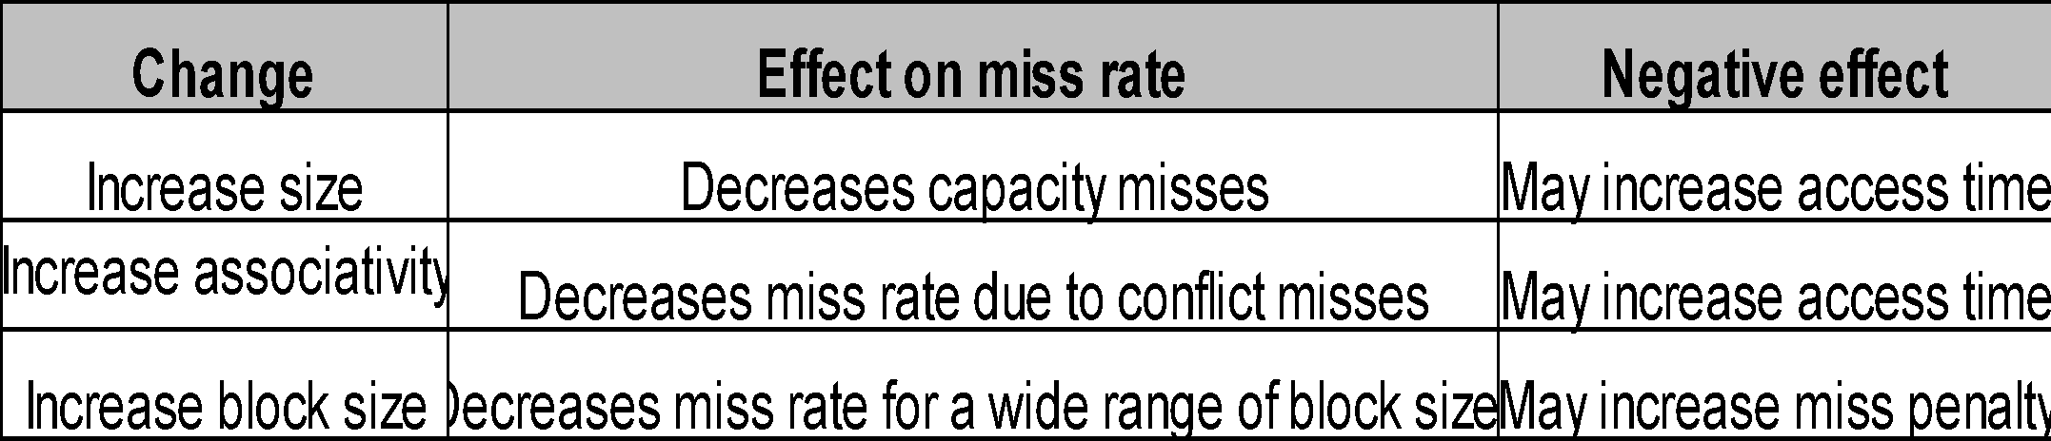
Design Tradeoffs
As in everything in engineering, multiple design tradeoffs exist when discussing memory hierarchies
There are many more factors involved, but the presented ones are the most important and accessible ones

Slide 57
Example
A computer system contains a main memory of 32K 16-bit words. It has also a 4Kword cache divided into 4-line sets with 64 words per line. The processor fetches words from locations 0, 1, 2,…, 4351 in that order sequentially 10 times. The cache is 10 times faster than the main memory. Assume LRU policy.
With no cache
Fetch time = (10 passes) (68 blocks/pass) (10T/block) = 6800T
With cache
Fetch time = (68) (11T) first pass
+ (9) (48) (T) + (9) (20) (11T) other passes
= 3160T
Improvement = 2.15

Slide 58
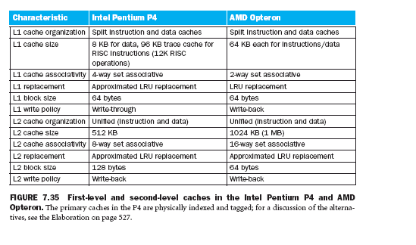
Modern Systems
Notes:
‹#›

Slide 59
Questions
What is the difference between DRAM and SRAM in terms of applications?
What is the difference between DRAM and SRAM in terms of characteristics such as speed, size and cost?
Explain why one type of RAM is considered to be analog and the other digital.
What is the distinction between spatial and temporal locality?
What are the strategies for exploring spatial and temporal locality?
What is the difference among direct mapping, associative mapping and set-associative mapping?
List the fields of the direct memory cache.
List the fields of associative and set- associative caches.

